Slide 1
IE 198 Case 2
THE POWER OF CHOICE
IE 198 CASE 2
BY: PAULA MARTINEZ

Slide 2
PART 1 THE POWER OF CHOICE
IE 198 Case 2
To make Google Maps more relevant to users, it must be able to provide its users the ability to streamline their dining preferences – to equip them with the power of choice.
The current interface of Google Maps is what may be described as the bare minimum. But because we are consumers, and we always want to maximize our happiness (assuming we are rational), and Google Maps is not giving us that as of the moment.

Slide 3
IE 198 Case 2
PART 1 THE POWER OF CHOICE
For this case, my proposed solution is to expand and accelerate the access of users to information, primarily by improving the available filters.
First filter: By type of food. This will ease the access of users to their dining preferences as they would immediately see what they are looking for. I also suggest that this be the default indicators in the map.
Second filter: By cuisine. This is similar to the first filter, except that this aims to streamline the food origin in this case.
Third filter: By type of service

Slide 4














FILTER 1: BY TYPE OF FOOD
IE 198 Case 2
PART 1 THE POWER OF CHOICE
Coffee Shop
Burger Joint
Desserts
Noodle House
Wines
and Spirits
Pizza Parlor
Milktea Shop

Slide 5
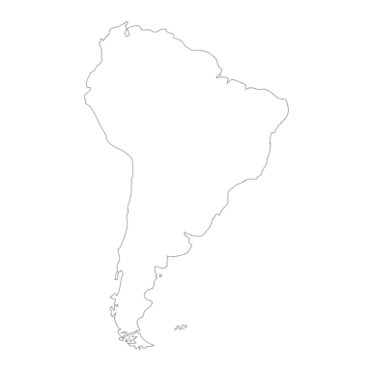

















IDEAL MAP IMPLEMENTATION BY TYPE OF FOOD
IE 198 Case 2
PART 1 THE POWER OF CHOICE
Note: The map is not an actual map of the Philippines. It was taken in the icons produced by MS PowerPoint.

Slide 6








FILTER 2: BY CUISINE
IE 198 Case 2
PART 1 THE POWER OF CHOICE
Filipino
Japanese
American
Korean
Italian
Chinese
Arabic

Slide 7

IDEAL MAP IMPLEMENTATION BY CUISINE
IE 198 Case 2
PART 1 THE POWER OF CHOICE
Note: The map is not an actual map of the Philippines. It was taken in the icons produced by MS PowerPoint.

Slide 8




FILTER 3: BY TYPE OF SERVICE
IE 198 Case 2
PART 1 THE POWER OF CHOICE
Dine-In
Takeout

Slide 9


IDEAL MAP IMPLEMENTATION BY CUISINE
IE 198 Case 2
PART 1 THE POWER OF CHOICE
Note: The map is not an actual map of the Philippines. It was taken in the icons produced by MS PowerPoint.

Slide 10

IMPLEMENTING THE POWER OF CHOICE
IE 198 Case 2
PART 1 THE POWER OF CHOICE
On the right is how the “More Filters” Panel of Google Maps look like.
To implement our modifications earlier, this panel must be utilized more effectively.
There should be additional filters that would allow users to filter by type of food, cuisine, type of service, price range, operating hours, and rating.
For the operating hours, there should also be an option to indicate the starting and ending hours, as well as the days of the week that the restaurant is open.

Slide 11
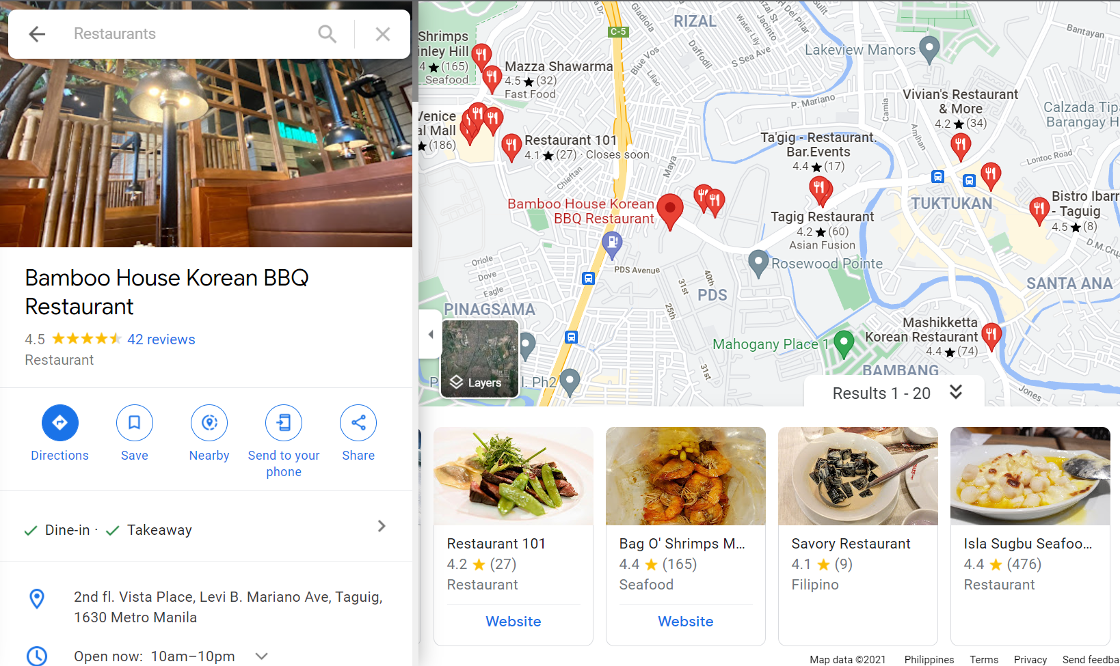
ADDITIONAL IMPLEMENTATIONS
IE 198 Case 2
PART 1 THE POWER OF CHOICE
The user must be provided with complete information when they click on a certain restaurant.
In the example on the left, there is no estimate of the price and contact details of the restaurant
In general, I suggest that the following information be included in viewing all restaurants: average price per person, operating hours (days and hour), rating, online and offline contact details.

Slide 12
IE 198 Case 2
DATA VIZUALIZATION
IE 198 CASE 2 PART 2
BY: PAULA MARTINEZ

Slide 13
INTRODUCTION
IE 198 Case 2
PART 2 DATA VIZUALIZATION

Slide 14
IE 198 Case 2
PART 2 DATA VIZUALIZATION
14
For Case 2, I used the suicide dataset to generate the following charts:
Horizontal bar chart
Scatterplot
Heat map

Slide 15
IE 198 Case 2
PART 2 DATA VIZUALIZATION
15
CHART NO. 1
HORIZONTAL BAR CHART
# DATA PRE-PROCESSING
import pandas as pd
suicide = pd.read_csv("C:/Users/Pau/OneDrive - University of the Philippines/Year 4/IE 198/Week 3/Case 2/Datasets/suicide.csv")
sui_agesex = suicide.copy()
# RETAINING SUICIDE RATE AND AGE RANGE ONLY
sui_agesex.drop(["country", "year", "suicides_no", "population", "country-year", "HDI for year", "gdp_for_year ($)", "gdp_per_capita ($)", "generation"], axis = 1, inplace = True)
# RENAMING COLUMNS
sui_agesex.rename(columns = {"age" : "Age", "sex": "Sex"}, inplace = True)
# GETTING THE AVERAGE SUICIDE RATE PER AGE RANGE
by_agesex = sui_agesex.groupby(["Age", "Sex"]).mean()
# LONG TO WIDE FORMAT
wide = by_agesex.pivot_table(index="Age", columns = "Sex", values = "suicides/100k pop")
# NEW COLUMN FOR THE AVERAGE PER AGE RANGE
wide['avg per age'] = (wide['female'] + wide['male'])/2
print(wide)
# SORTING THE VALUES ASCENDINGLY
wide = wide.sort_values(by = "avg per age", ascending = True)
# DROPPING THIS COLUMN FOR VISUALIZATION
wide.drop("avg per age", axis=1, inplace = True)
# CREATING THE HORIZONTAL STACKED BAR CHART
wide.plot.barh(
stacked = True,
color = ["lightgray", "cornflowerblue"],
title = "Average Suicide Rate per 100,000 Population",
)

Slide 16
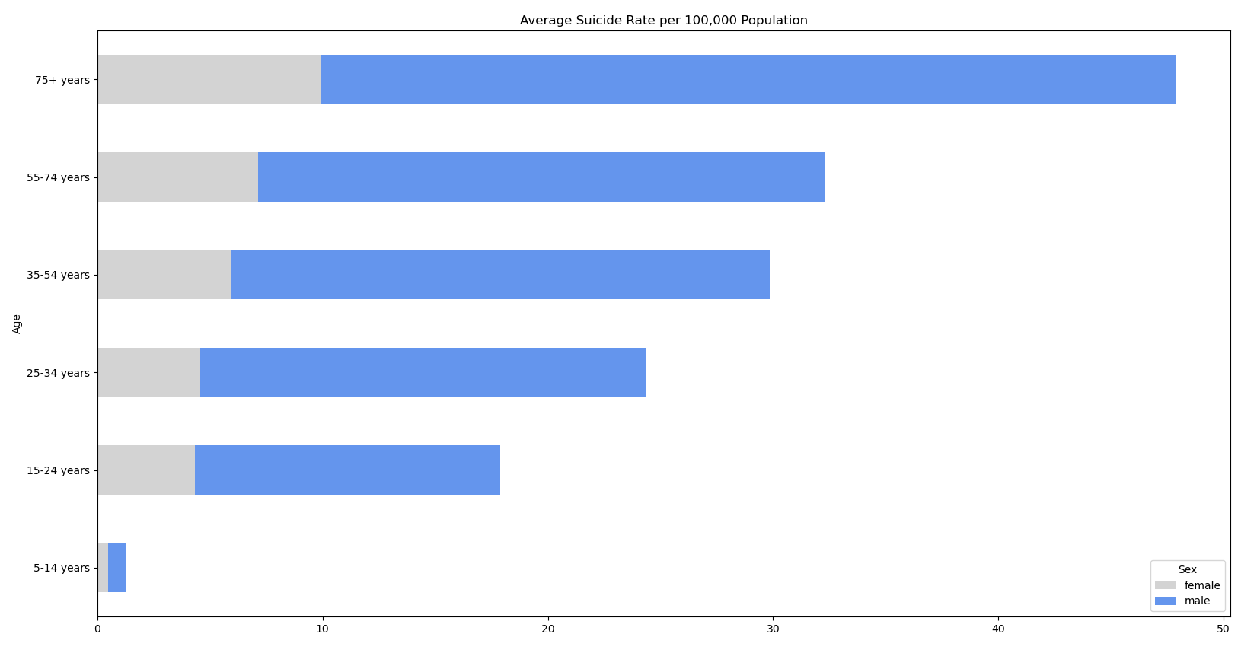
IE 198 Case 2
PART 2 DATA VIZUALIZATION
16
This bar chart aims to answer which age range has the highest average suicide rate in a population of 100,000, and which gender in each age range was likely to die more from suicide from 1987 to 2014. Our data tells us that male individuals who are 75+ years and older recorded the highest number of deaths by suicide from 1987 to 2014.

Slide 17
IE 198 Case 2
PART 2 DATA VIZUALIZATION
17
CHART NO. 2
SCATTERPLOT
import seaborn as sns
import pandas as pd
import numpy as np
sui_rategdp = suicide.copy()
# REMOVING UNNEEDED COLUMNS
sui_rategdp.drop(['year', 'sex', 'age', 'population', 'country-year', 'HDI for year', 'gdp_for_year ($)', 'generation'], axis = 1, inplace=True)
# GETTING THE MEAN VALUES PER COUNTRY
by_country = sui_rategdp.groupby('country').mean().reset_index()
# GETTING AN INITIAL PICTURE OF THE RELATIONSHIP BETWEEN VARIABLES
sns.pairplot(by_country) # Getting the histogram and scatterplot of each variable and with each other!
# From the pairplot, we see that there is an inverse relationship between suicide rate/100k population and gdp per capita.
# We also see that all the 3 numerical variables are skewed to the right.
# To show these variables in future plots, we can transform them by the square root of the values.
# CREATING COLUMNS FOR THE SQRT TRANSFORMATION
by_country['sqrt_gdp_per_cap'] = np.sqrt(by_country['gdp_per_capita ($)'])
by_country['sqrt_suicide#'] = np.sqrt(by_country['suicides_no'])
by_country['sqrt_suicide_rate'] = np.sqrt(by_country['suicides/100k pop'])

Slide 18
IE 198 Case 2
PART 2 DATA VIZUALIZATION
18
CHART NO. 2
SCATTERPLOT
# CREATING A NEW DF WITH ONLY THE SQRT VALUES, AND REMOVING THESE VALUES FROM BY_COUNTRY
sqrt_form = by_country.drop(columns = ['suicides/100k pop', 'gdp_per_capita ($)', 'suicides_no'], inplace = False)
by_country.drop(columns = ["sqrt_gdp_per_cap", "sqrt_suicide#", "sqrt_suicide_rate"], inplace = True)
# CHECKING IF THE DISTRIBUTION IS NOW BETTER
sns.pairplot(sqrt_form)
# CREATING THE REGRESSION SCATTERPLOT
sns.jointplot(x = 'sqrt_gdp_per_cap', y = 'sqrt_suicide_rate', data = sqrt_form, kind = 'reg')

Slide 19
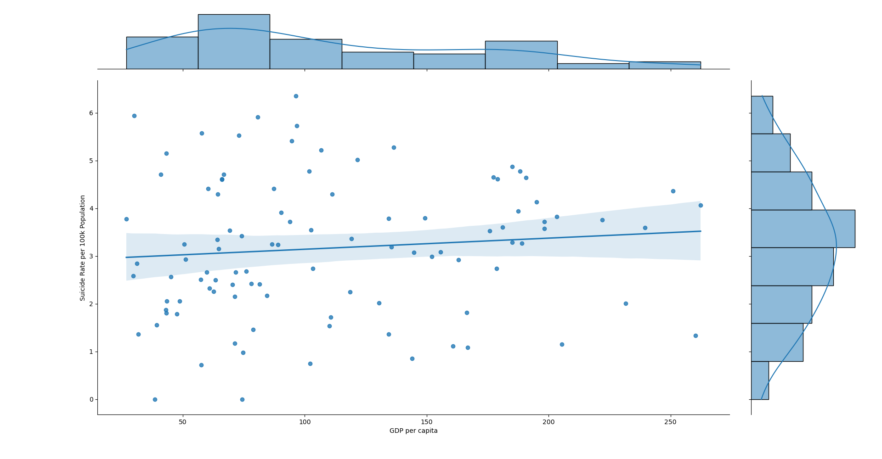
IE 198 Case 2
PART 2 DATA VIZUALIZATION
19
This scatterplot aims to establish a relationship between GDP per capita and suicide rate per 100,000 population. According to this chart, there is a minimal correlation between GDP per capita and suicide rate; countries with a low GDP per capita also have high suicide rate per 100,000 people on average.

Slide 20
IE 198 Case 2
PART 2 DATA VIZUALIZATION
20
CHART NO. 3
HEAT MAP
# HEAT MAP
import plotly.graph_objects as go
import plotly
import pandas as pd
suicide = pd.read_csv("C:/Users/Pau/OneDrive - University of the Philippines/Year 4/IE 198/Week 3/Case 2/Datasets/suicide.csv")
df = suicide.copy()
# FILE FOR THE CODE OF EACH COUNTRY (TAKEN FROM: https://plotly.com/python/choropleth-maps/)
locations = pd.read_csv('https://raw.githubusercontent.com/plotly/datasets/master/2014_world_gdp_with_codes.csv')
# RETAINING COUNTRIES AND THEIR SUICIDE RATE
df.drop(columns = ['year', 'sex', 'age', 'population', 'country-year', 'HDI for year', 'gdp_for_year ($)', 'generation', 'suicides_no', 'gdp_per_capita ($)'], axis = 1, inplace=True)
# GROUPING BY COUNTRY, GETTING THE MEAN SUICIDE RATE, THEN RESETTING THE INDEX
group_country = df.groupby('country').mean().reset_index()
fig = go.Figure(data = go.Choropleth(
locations = locations['CODE'],
z = group_country['suicides/100k pop'].astype(float),
text = locations['COUNTRY'],
colorscale = 'Blues',
autocolorscale = False,
reversescale = False,
marker_line_color = 'darkgray',
marker_line_width = 0.5,
colorbar_title = 'Average Suicide Rate',
))

Slide 21
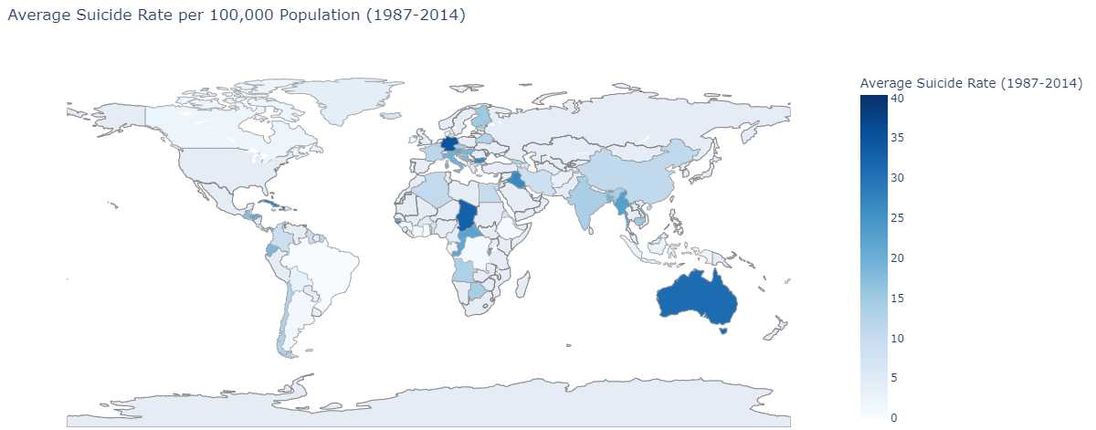
IE 198 Case 2
PART 2 DATA VIZUALIZATION
21
This heat map shows the relative average suicide rate of countries from 1987 to 2014. From this chart, see that countries in Europe and South Africa have a higher suicide rate relative to other countries (perhaps except Australia).

